Slide 1
Reliable Data Transfer
Project Presentation
张嘉兮 张淘月 黎诗龙
CS305 Term Project
2020/12/29

Slide 2
Content
- Design and Implementation
- Results and Features
- Problems and Solutions

Slide 3
Design and Implementation
- Many Design Imitate the python socket and TCP
- Events Mechanism
- Packet Header
- Checksum
- Congestion Control

Slide 4
RDT Socket
RDT Socket
Bind + accept
(Bind +) connect
Simple RDT
Client(Simple RDT)
Server
Simple RDT
Event Loop
Event Loop
USocket
USocket

Slide 5
Imitate the TCP
Three-Way Handshake
Four-Way Handshake
Cumulative ACK
SACK for Out-of-order Packets

Slide 6
Events Mechanism
Forever loop --> process the event queue
Main
Events
Send/Close
1 thread
Start/Send/Close
Start/Close
Event of Packet
Error
Send
Receive
1 thread
1 thread
Notes:
多线程 阻塞 非阻塞都能实现

Slide 7
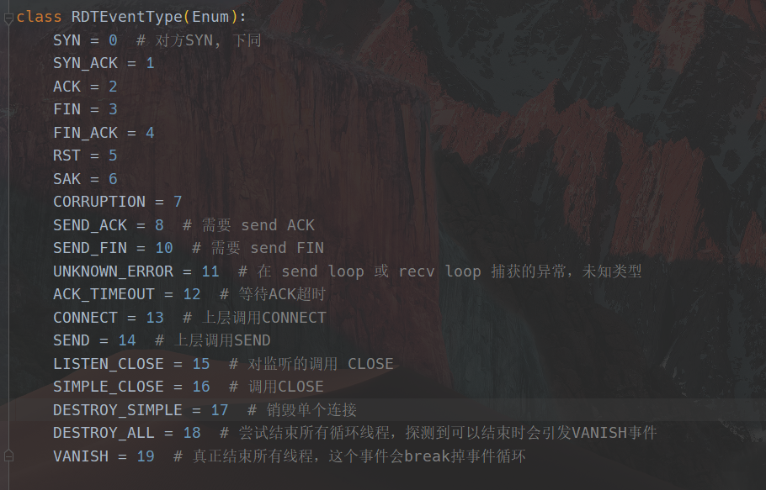
Events

Slide 8
Packet Header
NAME | VALUE
SYN | 1 bit
ACK | 1 bit
FIN | 1 bit
RST | 1 bit
SAK | 1 bit
Placeholder | 3 bits
SEQ / SEQ_SAK (If SAK) | 4 Bytes
SEQ_ACK | 4 Bytes
LEN | 2 Bytes
CHECKSUM | 2 Bytes
PAYLOAD | LEN Bytes

Slide 9
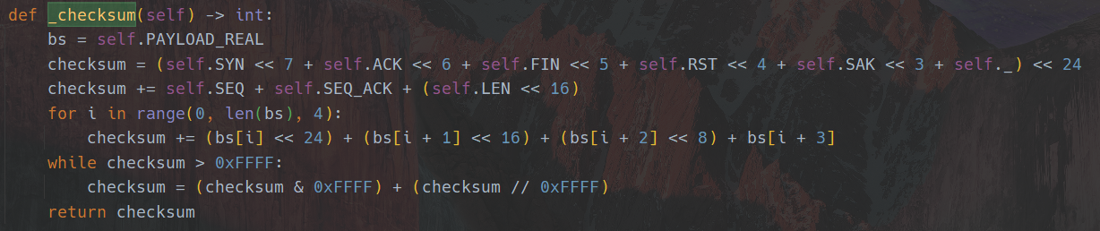
Checksum

Slide 10
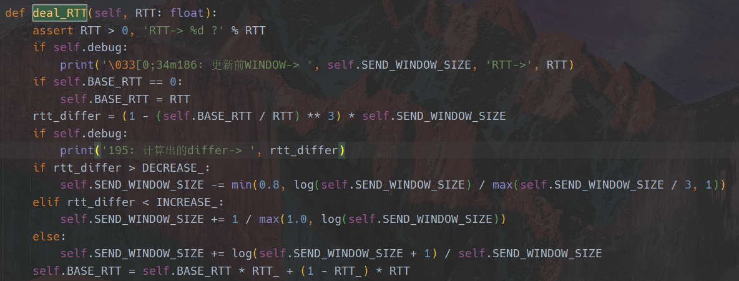

Congestion Control—Vegas
- Initialize the window size to 3
- Congestion Handling

Slide 11
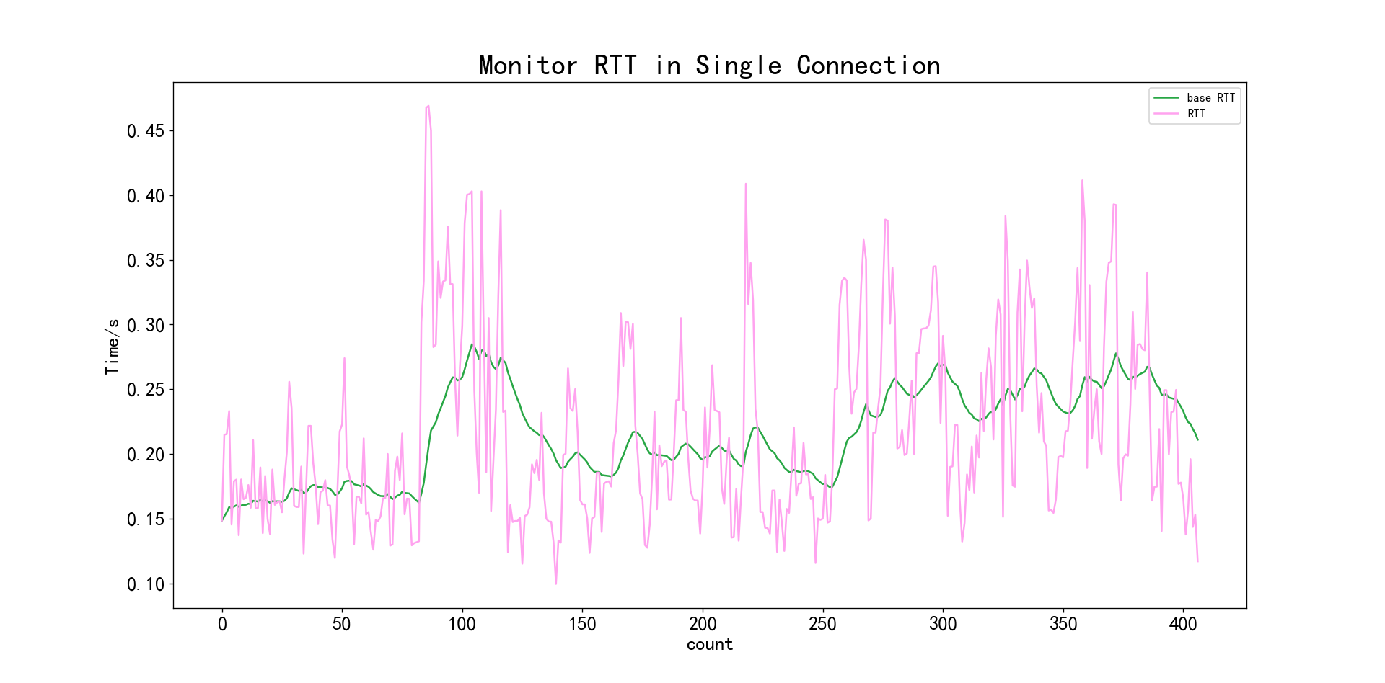
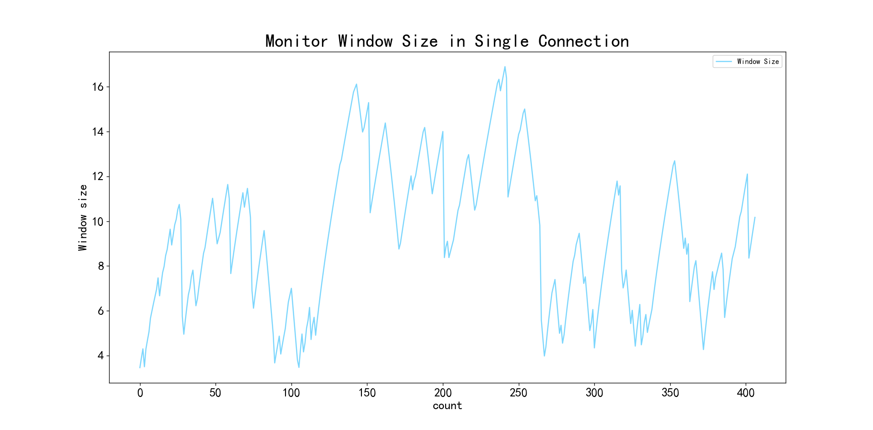
Results
Monitor RTT/Base RTT and Window Size in
Packet Loss Rate:0.1 Corruption Rate: 5e-5
Link Rate: 100KB/s

Slide 12
Results
1 server & 1 client packet loss rate:0.1 corruption rate: 5e-5

Slide 13
Results
2 server & 2 clients packet loss rate:0.1 corruption rate: 5e-5

Slide 14
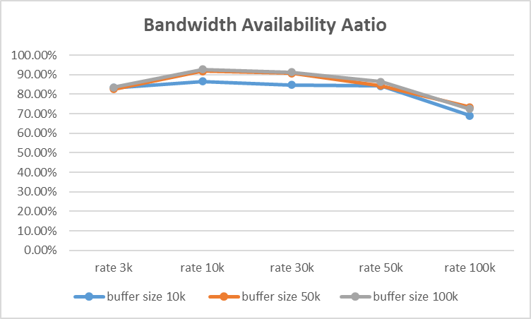
Results
2 server & 2 clients no packet loss, no corruption

Slide 15
Features
- Non-blocking
- Learn from Python Socket
- Events Mechanism
- Congestion Control

Slide 16
Problems and Solutions
How to deal with the loss of the last FIN packet?
It is hard to handle, so we simplify the implementation.
Send 3 independent FIN packets at one time.
Set a timer of destroying the RDTSocket as 16 RTT.
Automatically close the connection after the timer trigger if the connection has not been closed.

Slide 17
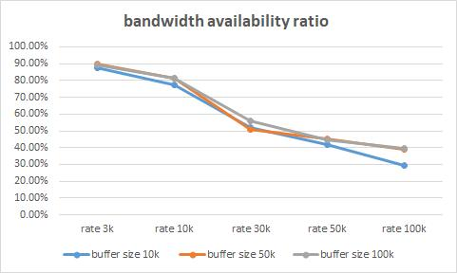
Problems and Solutions
Different results from different testing environment
This has not been solved.

Slide 18
Thanks!

